Slide 1
Operational Amplifier
Understand the properties of ideal amplifiers and the concepts of gain, input impedance, and output impedance.
Understand the difference between open-loop and closed-loop op-amp configurations; and compute the gain of (or complete the design of) simple inverting, noninverting, summing, and differential amplifiers using ideal op-amp analysis.

Slide 2
Operational Amplifier
Analyze more advanced op-amp circuits, using ideal op-amp analysis; and identify important performance parameters in op-amp data sheets.
Analyze and design simple circuit device such as active filters. Analyze and design ideal integrator and differentiator circuits.

Slide 3
Operational Amplifier - ideal amplifiers
Ideal amplifiers:
One of the most important functions in electronic instrumentation is that of amplification. The need to amplify low-level electric signals arises frequently in a number of applications.
Applications?

Slide 4
Operational Amplifier - ideal amplifiers
Ideal amplifiers:
Perhaps the most familiar use of amplifiers arises in converting the low-voltage signal from a cassette tape player, a radio receiver, or a compact disk player to a level suitable for driving a pair of speakers.

Slide 5
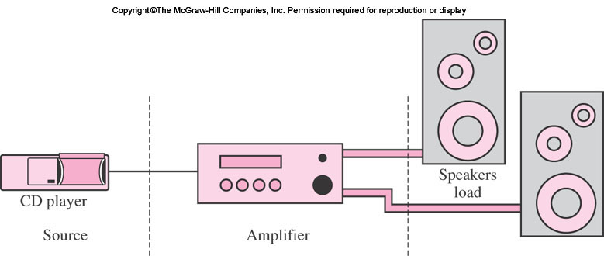
Operational Amplifier - ideal amplifiers
CD player, cassette tape player, a radio receiver, or a compact disk player to a level suitable for driving a pair of speakers.

Slide 6

Ideal Amplifier Characteristics
The simplest model for an amplifier is depicted in Figure 8.2, where a signal vS(t) is shown being amplified by a constant factor A, called the gain of the amplifier.
Ideally, the load voltage should be given by the expression

Slide 7
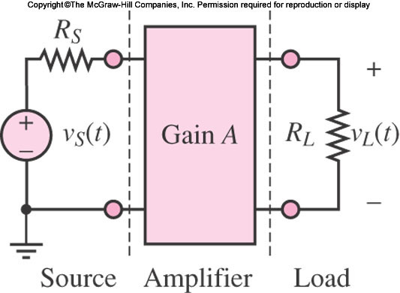
Ideal Amplifier Characteristics
Ideally, the load voltage should be given by the expression

Slide 8
Ideal Amplifier Characteristics
Note that the source has been modeled as a Thévenin equivalent, and the load as an equivalent resistance. Thévenin’s theorem guarantees that this picture can be representative of more complex circuits.

Slide 9
Ideal Amplifier Characteristics
Hence, the equivalent source circuit is the circuit the amplifier “sees” from its input port; and RL, the load, is the equivalent resistance seen from the output port of the amplifier.

Slide 10
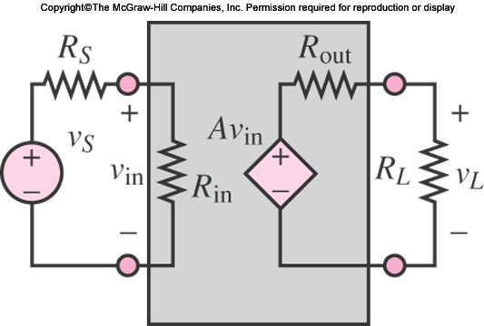
Ideal Amplifier Characteristics
Amplifier is a direct application of Thévenin’s theorem. Fig 8.3 provides a pictorial representation of this simplified characterization of an amplifier.
The “black box” of Figure 8.2 is now represented as an equivalent circuit with the following behavior.

Slide 11

Ideal Amplifier Characteristics
The input circuit has equivalent resistance Rin, so that the input voltage vin is given by
Voltage Divider Rule

Slide 12
Ideal Amplifier Characteristics
The equivalent input voltage seen by the amplifier is then amplified by a constant factor A. This is represented by the controlled voltage source Avin.

Slide 13

Ideal Amplifier Characteristics
The controlled source appears in series with an internal resistor Rout, denoting the internal (output) resistance of the amplifier. Thus, the voltage presented to the load is
Voltage Divider Rule

Slide 14

Ideal Amplifier Characteristics
by substituting the equation for vin,
Voltage Divider Rule

Slide 15

Ideal Amplifier Characteristics
If the input resistance of the amplifier Rin were very large, the source voltage vS and the input voltage vin would be approximately equal:
Because of

Slide 16
Ideal Amplifier Characteristics
If the An operational amplifier is an integrated circuit (IC), that is, a large collection of individual electric and electronic circuits integrated on a single silicon wafer.
An operational amplifier—or op-amp—can perform a great number of operations, such as addition, filtering, and integration, which are all based on the properties of ideal amplifiers and of ideal circuit elements.

Slide 17
References
Giorgio Rizzoni, “Fundamentals of Electrical Engineering”, McGraw- Hill Education, 2009. ISBN. 978-0-07-338037-7
Peyton Z. Peebles (Author), Tayeb A. Giuma, Principles of Electrical Engineering (Mcgraw Hill Series in Electrical and Computer Engineering), Mcgraw-Hill College, 1991.
Allan R. Hambley, Electrical Engineering: Principles and Applications, Prentice Hall, ISBN-0132130068, 9780132130066, 2011.

Slide 18
Thank you !
Question?

